Slide 1
Learning Curves & Tensorboard

Slide 2
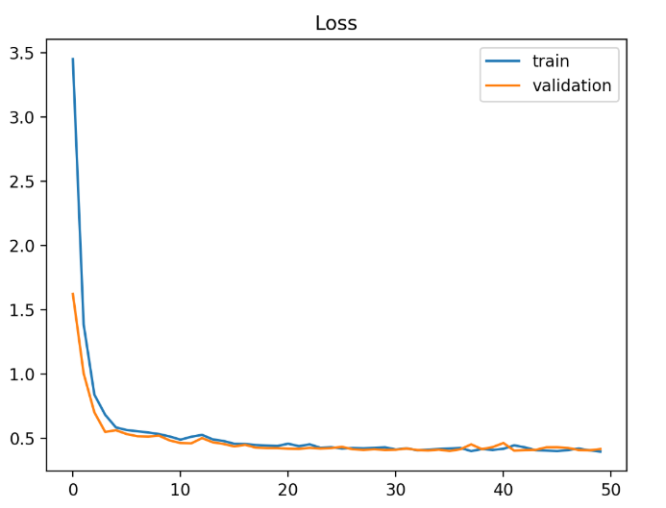
Learning Curves
学习曲线是模型学习能力随时间变化的曲线。
训练和验证数据集上模型性能的学习曲线可用于诊断欠拟合，过拟合或拟合良好的模型。
学习曲线可用于诊断训练或验证数据集是否具有代表性。

Slide 3
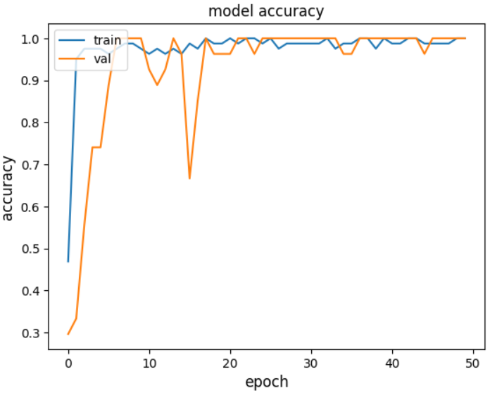
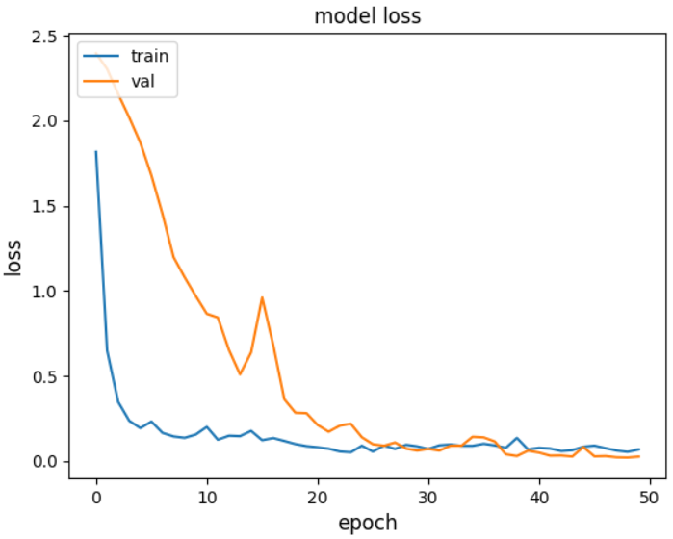
Learning Curves
Learning curves are widely used in machine learning for algorithms that learn (optimize their internal parameters) incrementally over time, such as deep learning neural networks.
The metric used to evaluate learning could be maximizing, meaning that better scores (larger numbers) indicate more learning.
It is more common to use a score that is minimizing, such as loss or error whereby better scores (smaller numbers) indicate more learning

Slide 4

Learning Curves in Machine Learning
Train Learning Curve: Learning curve calculated from the training dataset that gives an idea of how well the model is learning.
Validation Learning Curve: Learning curve calculated from a hold-out validation dataset that gives an idea of how well the model is generalizing.
Optimization Learning Curves: Learning curves calculated on the metric by which the parameters of the model are being optimized, e.g. loss.
Performance Learning Curves: Learning curves calculated on the metric by which the model will be evaluated and selected, e.g. accuracy.

Slide 5
Diagnosing Model Behavior
The shape and dynamics of a learning curve can be used to diagnose the behavior of a machine learning model and in turn perhaps suggest at the type of configuration changes that may be made to improve learning and/or performance.
Underfit（欠拟合）
Overfit（过拟合）
Good fit（适度拟合）

Slide 6
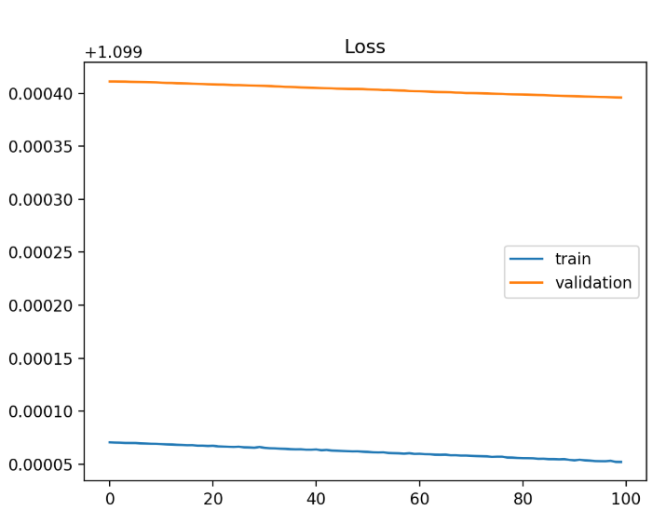
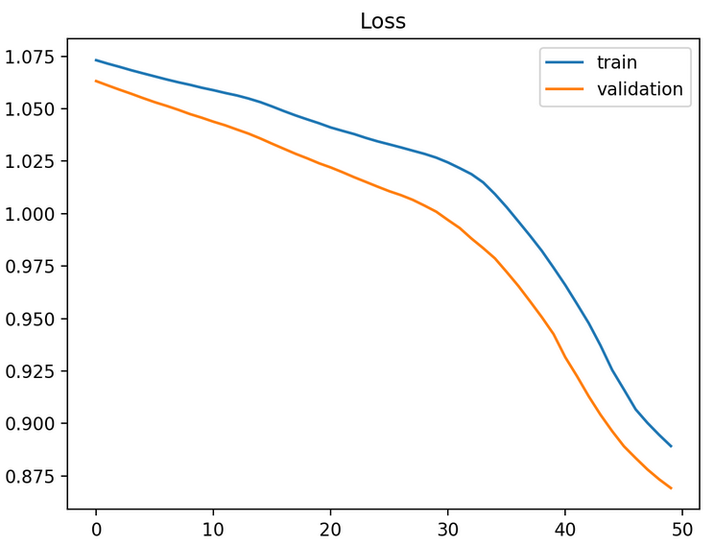
Underfit Learning Curves
Underfitting occurs when the model is not able to obtain a sufficiently low error value on the training set.
A plot of learning curves shows underfitting if:
The training loss remains flat regardless of training.
The training loss continues to decrease until the end of training.

Slide 7
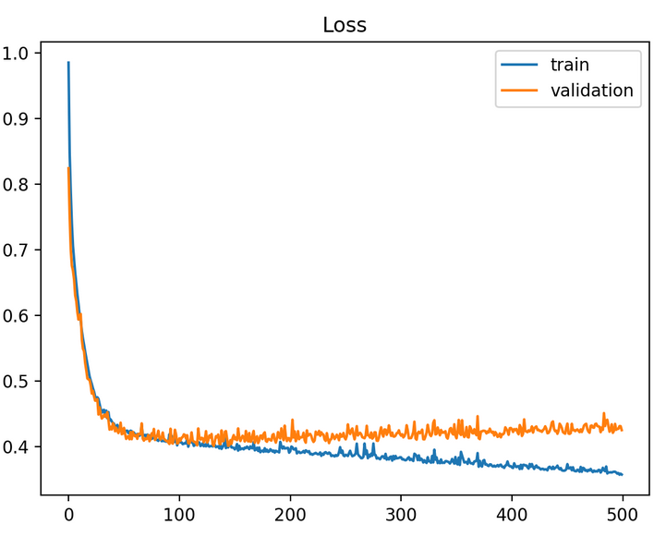
Overfit Learning Curves
Overfitting refers to a model that has learned the training dataset too well, including the statistical noise or random fluctuations in the training dataset.
A plot of learning curves shows overfitting if:
The plot of training loss continues to decrease with experience.
The plot of validation loss decreases to a point and begins increasing again.

Slide 8
Good Fit Learning Curves
A good fit is the goal of the learning algorithm and exists between an overfit and underfit model.
A good fit is identified by a training and validation loss that decreases to a point of stability with a minimal gap between the two final loss values.
A plot of learning curves shows a good fit if:
The plot of training loss decreases to a point of stability.
The plot of validation loss decreases to a point of stability and has a small gap with the training loss.

Slide 9
Diagnosing Unrepresentative Datasets
Learning curves can also be used to diagnose properties of a dataset and whether it is relatively representative.
An unrepresentative dataset means a dataset that may not capture the statistical characteristics relative to another dataset drawn from the same domain, such as between a train and a validation dataset. This can commonly occur if the number of samples in a dataset is too small, relative to another dataset.
There are two common cases that could be observed; they are:
Training dataset is relatively unrepresentative.
Validation dataset is relatively unrepresentative.

Slide 10
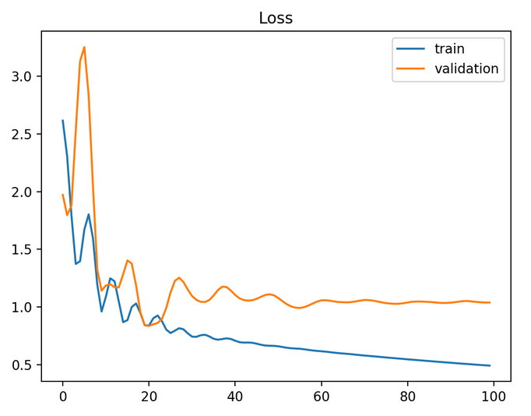
Unrepresentative Train Dataset
An unrepresentative training dataset means that the training dataset does not provide sufficient information to learn the problem, relative to the validation dataset used to evaluate it.
This may occur if the training dataset has too few examples as compared to the validation dataset.
This situation can be identified by a learning curve for training loss that shows improvement and similarly a learning curve for validation loss that shows improvement, but a large gap remains between both curves.

Slide 11
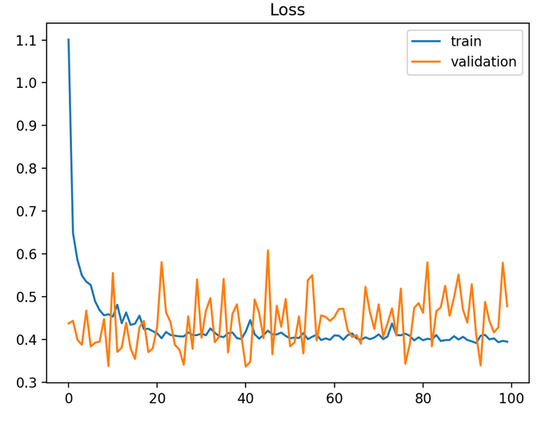
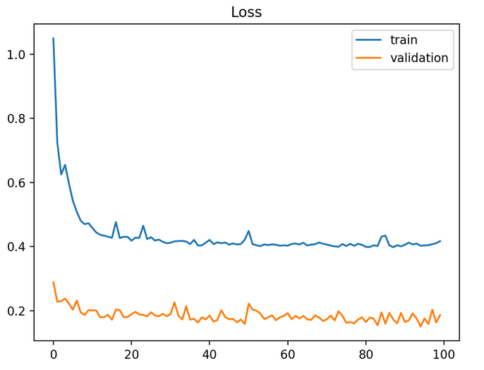
Unrepresentative Validation Dataset
An unrepresentative validation dataset means that the validation dataset does not provide sufficient information to evaluate the ability of the model to generalize.
This may occur if the validation dataset has too few examples as compared to the training dataset.

Slide 12
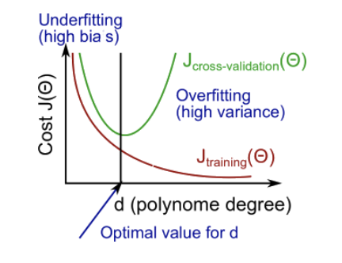

Diagnosing bias vs. variance
偏差: 描述模型输出结果的期望与样本真实结果的差距。
方差: 描述模型对于给定值的输出稳定性。
High bias -> Underfitting
High variance -> Overfitting
高偏差导致欠拟合，高方差导致过拟合

Slide 13
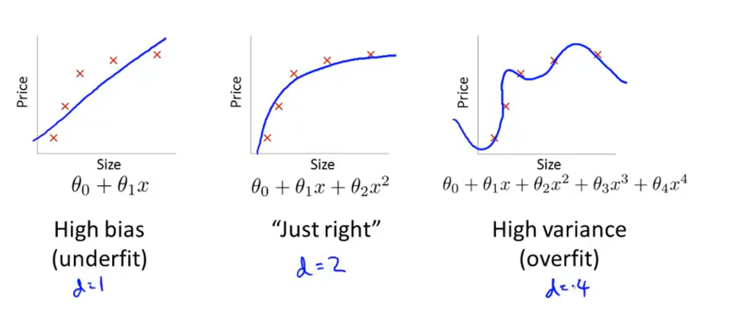
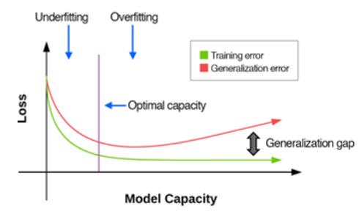
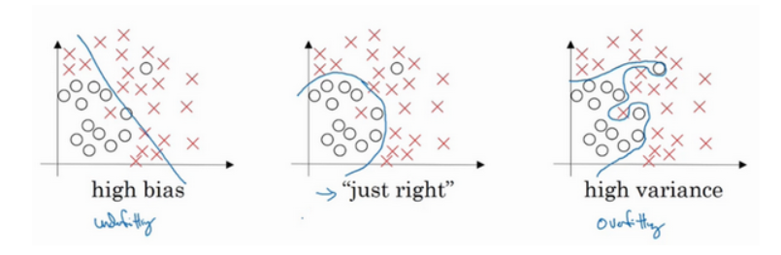
Diagnosing bias vs. variance
回归（regression）问题中的三种拟合状态
分类（classification）问题中的三种拟合状态

Slide 14
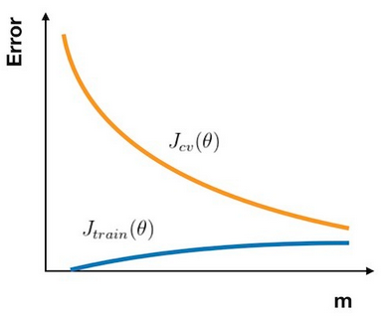
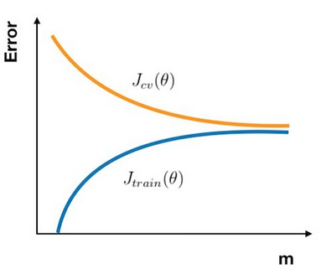
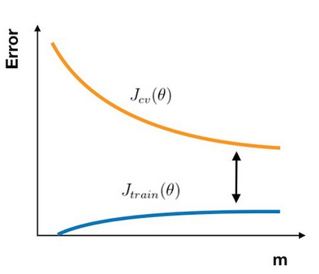
Learning curves
normal
High bias
High variance

Slide 15
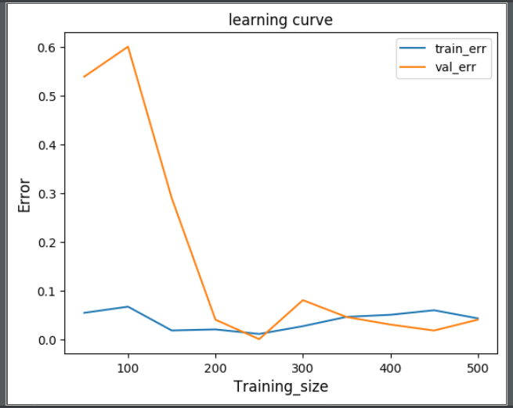
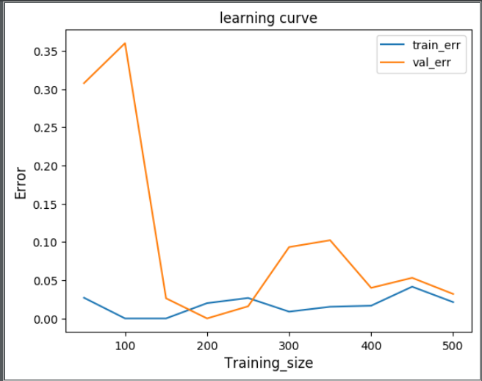
Learning curves
FCN：
Resnet:

Slide 16
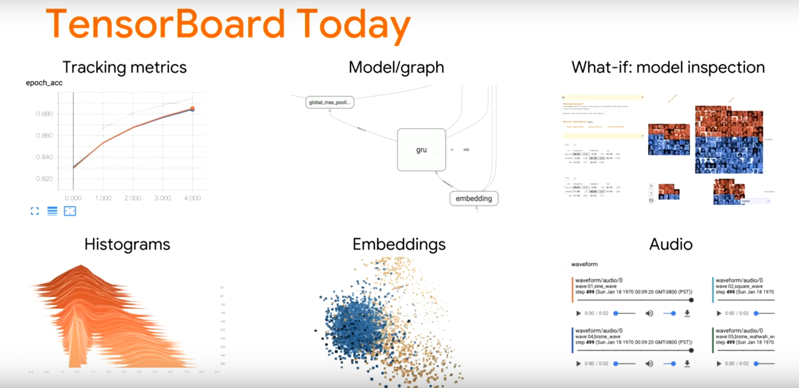

Slide 17
Tensorboard的作用
网络往往都是很复杂的，为了方便调试参数以及调整网络结构，我们需要将计算图、以及训练过程中的各种指标可视化出来，以便能够更好的进行下一步的决策。
Tensorboard是可视化tensorflow模型的训练过程的工具，在安装tensorflow的同时就已经安装好了tensorboard。
Tensorboard能够有效地展示tensorflow在运行过程中的计算图、各种指标随着时间的变化趋势以及训练中使用到的数据信息

Slide 18
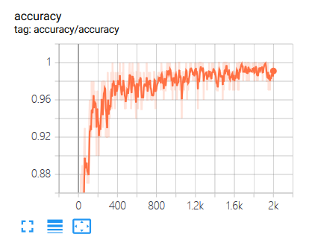
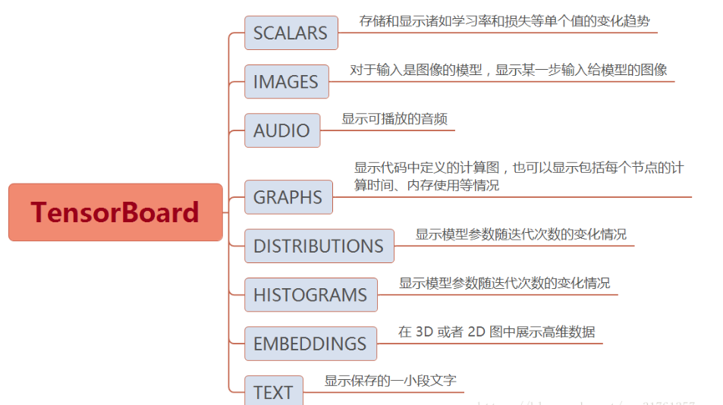
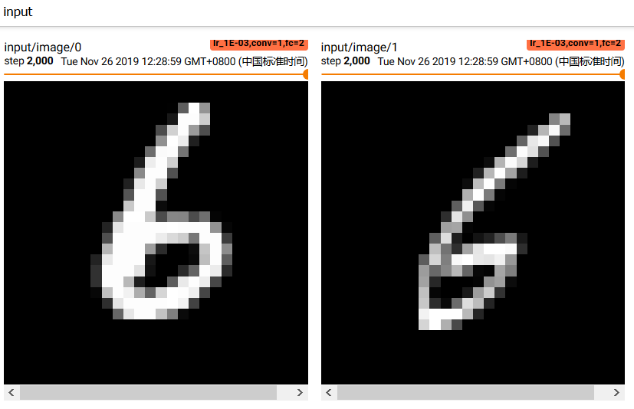
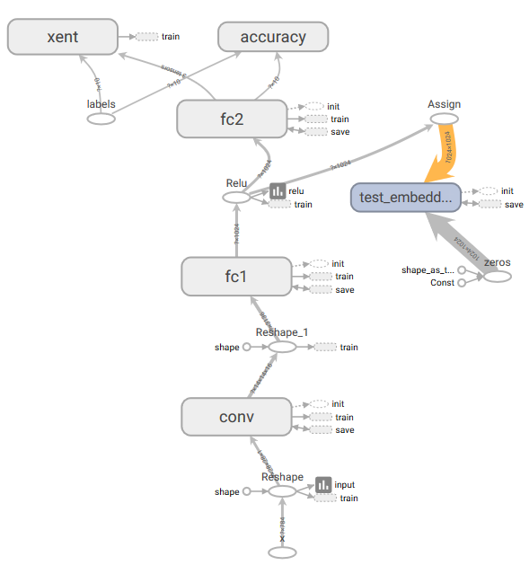

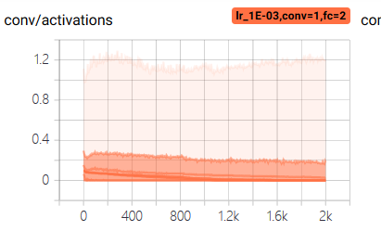
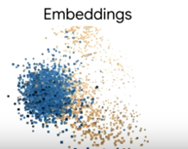
Tensorboard中的数据形式

Slide 19
Tensorboard的工作流程
Tensorboard是通过一些操作将数据记录到文件中，然后再读取文件来完成作图的，关键的几个步骤如下：
summary：在定义计算图的时候，在适当的位置加上一些summary操作
merge：在训练的时候可能加了多个summary操作，需要使用 tf.summary.merge_all将这些summary操作合成一个操作，由它来产生所有的summary数据
run：在没有运行的时候这些操作是不会执行任何东西的，仅仅是定义了一下，在运行（开始训练）的时候，需要通过tf.summary.FileWrite()指定一个目录告诉程序把产生的文件放到哪，然后在运行的时候使用 add_summary() 来将某一步的 summary 数据记录到文件中

Slide 20
Tensorboard的运行
当训练完成后，在命令行使用
tensorboard –logdir path/to/log-directory 来启动 TensorBoard
按照提示在浏览器打开页面，注意把 path/to/log-directory 替换成自己指定的目录。

